Slide 1
Joins
&
Operators
Prepared For: CS527
Prepared By: Josh Levine, Pranav Shivkumar, Pratik Mistry, Shounak Rangwala, Swapnil Kamate, Vikhyat Dhamija

Slide 2
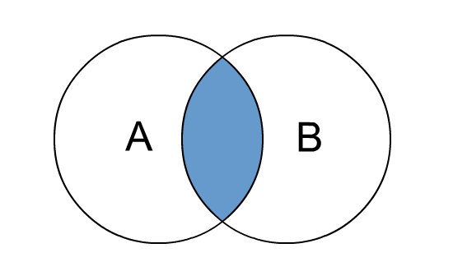
Inner Join
Will select records that have matching values in both tables.
If there are records in table A that do not have matches in table B or vice-versa, then those rows will not be selected.
Example:
Select a.*, b.* from a
Inner Join b On (a.id = b.id);

Slide 3
Query:
Select products.*, aisles.* from products Inner Join aisles On (products.aisle_id = aisles.aisle_id);
Products
Aisles
product_id | product_name | aisle_id | department_id
1 | Chocolate Sandwich | 1 | 19
2 | Salt | 2 | 13
3 | Tea | 3 | 7
4 | Sauce | 2 | 1
5 | Pizza | 10 | 5
aisle_id | aisle
1 | Dessert
2 | Seasons
3 | Drinks
4 | Medicine
5 | Food

Slide 4
Query:
Select products.*, aisles.* from products Inner Join aisles On (products.aisle_id = aisles.aisle_id);
Inner Join Result Table
product_id | product_name | aisle_id | department_id | aisle_id | aisle
1 | Chocolate Sandwich | 1 | 19 | 1 | Dessert
2 | Salt | 2 | 13 | 2 | Seasons
3 | Tea | 3 | 7 | 3 | Drinks
4 | Sauce | 2 | 1 | 2 | Seasons

Slide 5
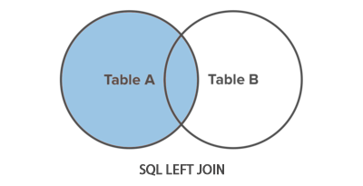
Left Outer Join
Will select ALL records from the left table (Table A), and the records that match in right table (Table B).
If there is no match, the result from the right table is NULL.
Example:
Select a.*, b.* from a
Left Join b On (a.id = b.id);

Slide 6
Query:
Select products.*, aisles.* from products Left Join aisles On (products.aisle_id = aisles.aisle_id);
Products
Aisles
product_id | product_name | aisle_id | department_id
1 | Chocolate Sandwich | 1 | 19
2 | Salt | 2 | 13
3 | Tea | 3 | 7
4 | Sauce | 2 | 1
5 | Pizza | 10 | 5
aisle_id | aisle
1 | Dessert
2 | Seasons
3 | Drinks
4 | Medicine
5 | Food

Slide 7
Query:
Select products.*, aisles.* from products Left Join aisles On (products.aisle_id = aisles.aisle_id);
Left Join Result Table
product_id | product_name | aisle_id | department_id | aisle_id | aisle
1 | Chocolate Sandwich | 1 | 19 | 1 | Dessert
2 | Salt | 2 | 13 | 2 | Seasons
3 | Tea | 3 | 7 | 3 | Drinks
4 | Sauce | 2 | 1 | 2 | Seasons
5 | Pizza | 10 | 5 | NULL | NULL

Slide 8
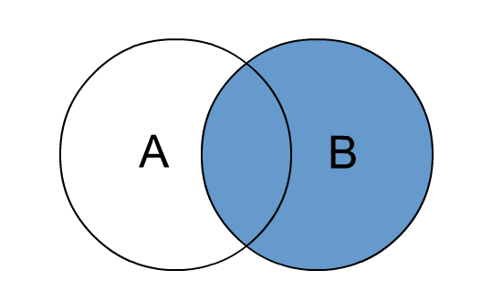
Right Outer Join
Will select records from the right table (Table B), and records that match from the left table (Table A).
If there is no match, the result from the left table in NULL.
Example:
Select a.*, b.* from a
Right Join b On (a.id = b.id);

Slide 9
Query:
Select products.*, aisles.* from products Right Join aisles On (products.aisle_id = aisles.aisle_id);
Products
Aisles
product_id | product_name | aisle_id | department_id
1 | Chocolate Sandwich | 1 | 19
2 | Salt | 2 | 13
3 | Tea | 3 | 7
4 | Sauce | 2 | 1
5 | Pizza | 10 | 5
aisle_id | aisle
1 | Dessert
2 | Seasons
3 | Drinks
4 | Medicine
5 | Food

Slide 10
Query:
Select products.*, aisles.* from products Right Join aisles On (products.aisle_id = aisles.aisle_id);
Right Join Result Table
product_id | product_name | aisle_id | department_id | aisle_id | aisle
1 | Chocolate Sandwich | 1 | 19 | 1 | Dessert
2 | Salt | 2 | 13 | 2 | Seasons
3 | Tea | 3 | 7 | 3 | Drinks
4 | Sauce | 2 | 1 | 2 | Seasons
NULL | NULL | NULL | NULL | 5 | Food

Slide 11
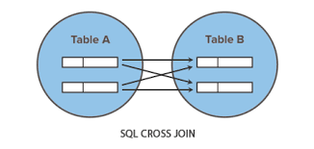
Cross Join
It produces a result set which is the number of rows in the first table multiplied by the number of rows in the second table. The result is also called Cross Product or Cartesian Product.
This result set is produced when no “WHERE” clause is used in the join
A common use for a cross join is to obtain all combinations of items.
Example:
Select a.*, b.* from a
Cross Join b On (a.id = b.id);

Slide 12
Query:
Select p.product_name, p.product_id, a.aisle from products p Cross Join aisles a
Products
Aisles
product_id | product_name | aisle_id | department_id
1 | Chocolate Sandwich | 1 | 19
2 | Salt | 2 | 13
aisle_id | aisle
1 | Dessert
2 | Seasons

Slide 13
Query:
Select p.product_name, p.product_id, a.aisle from products p Cross Join aisles a
Cross Join Result Table
product_id | product_name | aisle
1 | Chocolate Sandwich | Dessert
1 | Chocolate Sandwich | Seasons
2 | Salt | Dessert
2 | Salt | Seasons

Slide 14
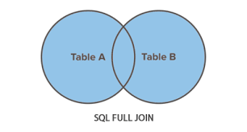
Full Join
Full Join returns all matching records from both tables whether the other table matches or not.
Full Join can return very large data sets.
Example:
Select a.*, b.* from a
Full Join b On (a.id = b.id);

Slide 15
Query:
Select products.*, aisles.* from products Full Join aisles On (products.aisle_id = aisles.aisle_id);
Products
Aisles
product_id | product_name | aisle_id | department_id
1 | Chocolate Sandwich | 1 | 19
2 | Salt | 2 | 13
3 | Tea | 3 | 7
4 | Sauce | 2 | 1
5 | Chicken | 5 | 9
aisle_id | aisle
1 | Dessert
2 | Seasons
3 | Drinks
4 | Medicine

Slide 16
Query:
Select products.*, aisles.* from products Full Join aisles On (products.aisle_id = aisles.aisle_id);
Full Join Result Table
product_id | product_name | aisle_id | department_id | aisle_id | aisle
1 | Chocolate Sandwich | 1 | 19 | 1 | Dessert
2 | Salt | 2 | 13 | 2 | Seasons
3 | Tea | 3 | 7 | 3 | Drinks
4 | Sauce | 2 | 1 | 2 | Seasons
5 | Chicken | 5 | 9 | NULL | NULL
NULL | NULL | NULL | NULL | 4 | Medicine

Slide 17
Self Join
Is used to join a table to itself as if the table were two tables.
They are also useful for comparisons within a table also when modeling hierarchies.
Example:
Select a.*, b.*
From table_ab a, table_ab b
Where a.id = b.id;

Slide 18
Query:
Select a.product_id, b.product_name From products a, products b where a.aisle_id = b.aisle_id;
Products
product_id | product_name | aisle_id | department_id
1 | Chocolate Sandwich | 1 | 19
2 | Salt | 2 | 13
3 | Tea | 3 | 7
4 | Sauce | 2 | 1
5 | Chicken | 5 | 9

Slide 19
Query:
Select a.product_id, b.product_name From products a, products b where a.aisle_id = b.aisle_id;
Self Join Result Table
product_id | product_name
2 | Salt
4 | Sauce

Slide 20
Exists - Operator
Used to test for the existence of any record in a subquery.
Will return true if the subquery returns one or more records.
Example:
Select a.*
From a
Where Exists (Select id from b where id ⇔ condition);

Slide 21
Query:
Select * From products Where Exists (Select aisle_id from aisles where aisle_id > 2);
Products
Aisles
product_id | product_name | aisle_id | department_id
1 | Chocolate Sandwich | 1 | 19
2 | Salt | 2 | 13
3 | Tea | 3 | 7
4 | Sauce | 2 | 1
aisle_id | aisle
1 | Dessert
2 | Seasons
3 | Drinks
4 | Medicine

Slide 22
Query:
Select * From products Where Exists (Select aisle_id from aisles where aisle_id > 2);
Result Table after using EXISTS Operator
product_id | product_name | aisle_id | department_id
3 | Tea | 3 | 7

Slide 23
Any - Operator
Is used with a Where or Having clause.
Having: used for aggregate functions.
Returns true if any of the subquery values meet the condition.
Example:
Select a.*
From a
Where id = Any (Select id from b where ⇔ condition);

Slide 24
Query:
Select * From products Where aisle_id = Any (Select aisle_id from aisles where aisle_id > 1);
Products
Aisles
product_id | product_name | aisle_id | department_id
1 | Chocolate Sandwich | 1 | 19
2 | Salt | 2 | 13
3 | Tea | 3 | 7
aisle_id | aisle
1 | Dessert
2 | Seasons
3 | Drinks
4 | Medicine

Slide 25
Query:
Select * From products Where aisle_id = Any (Select aisle_id from aisles where aisle_id > 1);
Result Table after using ANY Operator
product_id | product_name | aisle_id | department_id
2 | Salt | 2 | 13
3 | Tea | 3 | 7

Slide 26
All - Operator
Also used with a Where or Having clause.
Returns true if all of the subquery values meet the condition.
Example:
Select a.*
From a
Where id = ALL (Select id from b where value ⇔ condition);

Slide 27
Query:
Select * From products Where aisle_id = ALL (Select aisle_id from aisles where aisle_id = 2);
Products
Aisles
product_id | product_name | aisle_id | department_id
1 | Chocolate Sandwich | 1 | 19
2 | Salt | 2 | 13
3 | Tea | 3 | 7
4 | Sauce | 2 | 1
aisle_id | aisle
1 | Dessert
2 | Seasons
3 | Drinks
4 | Medicine

Slide 28
Query:
Select * From products Where aisle_id = ALL (Select aisle_id from aisles where aisle_id = 2);
Result Table after using ALL Operator
product_id | product_name | aisle_id | department_id
2 | Salt | 2 | 13
4 | Sauce | 2 | 1

Slide 29
Thank You

